Slide 1
Mission, vision and values

Slide 2
Founder – Adriano Brito, 33 years old
UFRJ, 2002, Computational Science Graduated
PUC, 2012, Master of Science Computational
Experience of 12 years on system developing
Experience of 10 years on game developing
Visionary Entrepreneur, Senior IT Architect and Team leader
More informations:
http://br.linkedin.com/in/adrianobrito

Slide 3
Mission
Provide artificial intelligence for game developers
Create an engine capable of generating bots online
Mentoring students to AI developing

Slide 4
Vision
To be the worldwide reference in the development of AI to games, generating services with practicality of integration and high quality
"There is no favorable wind for those
who do not know where to go"
Sêneca

Slide 5
Values
Commitment
Objectivity
Passion
Creativity
Innovation

Slide 6
AI Coverage
The online game market has moved million of dollars worldwide. This number only increases
In Brazil, the gamification is extremely warm and rise
The concept of Serious Games brought the theme of the importance of AI for both the academic and the corporate world
All of them need AI for something

Slide 7
Target
Small game developers
Small and medium game enterprises

Slide 8
Our solution
Providing AI custom services for games
Creating specific bots to download
Creating an online engine to create bots

Slide 9

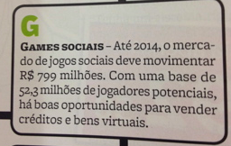
To reach them before
May 2012, PEGN Magazine
February 2012, Istoé Magazine

Slide 10

End

